Slide 1
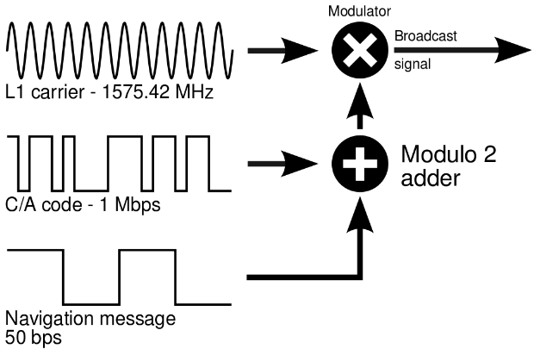
GPS signal structure

Slide 2
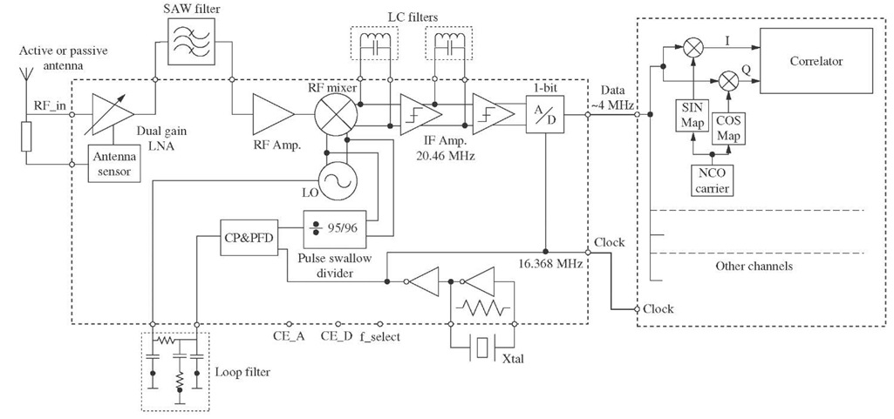
GPS front end
LO: 1555MHz or ?
Bandpass sampling: Images at f - nfs

Slide 3
GPS tasks
Tasks:
Matched filtering
Coherent & noncoherent Integration
Detection/Acquisition & Tracking
Satellite time & data extraction
GPS Position calculation

Slide 4
GPS interrupt structure
Interrupt structure:
250 us Serial port interrupt
1ms Matched filtering interrupt
10ms interrupt: coherent & incoherent integration
250ms scheduler: Satellite data processing
1s position computation interrupt
…
…
…
…
…
…
…
…
250us
…
…
1ms
10ms
250ms
1s

